Slide 1
Lab 1
61C Fall 2024

Slide 2
Compiling a C Program
gcc is used to compile C programs
gcc ex1.c test_ex1.c
ex1.c
test_ex1.c
gcc
a.out
Can specify the name of the executable file with the -o flag
gcc -o ex1 ex1.c test_ex1.c
Notes:
We will be using the command line program gcc to compile programs in C
If you've taken CS61B or have experience with Java, you can kinda think of gcc as the C equivalent of javac
The following command will compile ex1.c and test_ex1.c into an executable file named a.out
gcc ex1.c test_ex1.c
You can specify the name of the executable file with the -o flag
gcc -o ex1 ex1.c test_ex1.c

Slide 3
Running a C Program
To run an executable located in the current directory, use ./<executable_name>
./ex1
The dot refers to the current directory
If you want to run a file in a different directory, specify the path after the dot
./path/to/file/ex1

Slide 4
Variable Types and Sizes
Guarantee: sizeof(long long) >= sizeof(long) >= sizeof(int) >= sizeof(short)
To know for sure what size your variable is, use uintN_t or intN_t types.
char = 1 byte (8 bits)
short = usually 2 bytes (16 bits)
int = usually 4 bytes (32 bits)
unsigned int
float = 4 bytes (32 bits)
double = 8 bytes (64 bits)
long = at least 4 bytes (32 bits), can be longer
long long = at least 8 bytes (64 bits), can be longer

Slide 5
Defining a Function
Specify return type, function name, and function parameters.
int add(int x, int y) { return x + y; }
void nothing() { return; }

Slide 6
Conditionals
If-else
Switch statements
if (condition) { do this; } else if (condition) { do this; } else { do this; }
switch (expression) {
case constant1: do these;
break; case constant2:
do these;
break;
default:
do these; }

Slide 7
Loops
While loop
For loop
while (condition) {
do this; }
for (int i = 0; i < 10; i++) {
do this;
}

Slide 8
Pointers
Address
Data
int* x_ptr;
int x = 100;
x_ptr = &x;
100
0xebafb32c
x_ptr
&x
x
*
Type definition
e.g. int* x_ptr;
Add an * after a type makes the type a pointer type. In the example, we declare x_ptr variable as integer pointer type, and assign the address of variable x as its value.
You can also do int**, int***, int****, …
Dereference
e.g. *x_ptr
Add an * before a variable gets the value at address [variable]
&
Get the address of a variable (opposite of dereference)
&x

Slide 9
Assigning
int x = 19;
int* y = &x;
might produce something like:
Memory
x
&x
y
Address | Data
… | …
0x61c0 | 19
0x61c4 | 0x61c0
0x61c8 | 14
… | …

Slide 10
Assigning
(int* y = &x;)
int z = *y;
might produce something like:
Memory
Address | Data
… | …
0x61c0 | 19
0x61c4 | 0x61c0
0x61c8 | 19
… | …
*y / x
&x
y
z

Slide 11
Assigning
(int* y = &x;)
int z = *y;
*y = 20;
might produce something like:
Memory
Address | Data
… | …
0x61c0 | 20
0x61c4 | 0x61c0
0x61c8 | 19
… | …
*y / x
&x
y
z

Slide 12
Name | Value
x | 19
&x | 0x61c0
y | 0x61c0
*y | 19
Address | Binding | Data
0x61c0 | x | 19
0x61c4 | y | 0x61c0
0x61c8 | z | 14

Slide 13
&x gets the address of the variable x
Name | Value
x | 19
&x | 0x61c0
y | 0x61c0
*y | 19
Address | Binding | Data
0x61c0 | x | 19
0x61c4 | y | 0x61c0
0x61c8 | z | 14

Slide 14
To create a pointer, we need to declare y to be a pointer type:
int* y = &x;
Name | Value
x | 19
&x | 0x61c0
y | 0x61c0
*y | 19
Address | Binding | Data
0x61c0 | x | 19
0x61c4 | y | 0x61c0
0x61c8 | z | 14

Slide 15
*y follows the pointer in y, and gets the data stored at that address
Name | Value
x | 19
&x | 0x61c0
y | 0x61c0
*y | 19
Address | Binding | Data
0x61c0 | x | 19
0x61c4 | y | 0x61c0
0x61c8 | z | 14

Slide 16
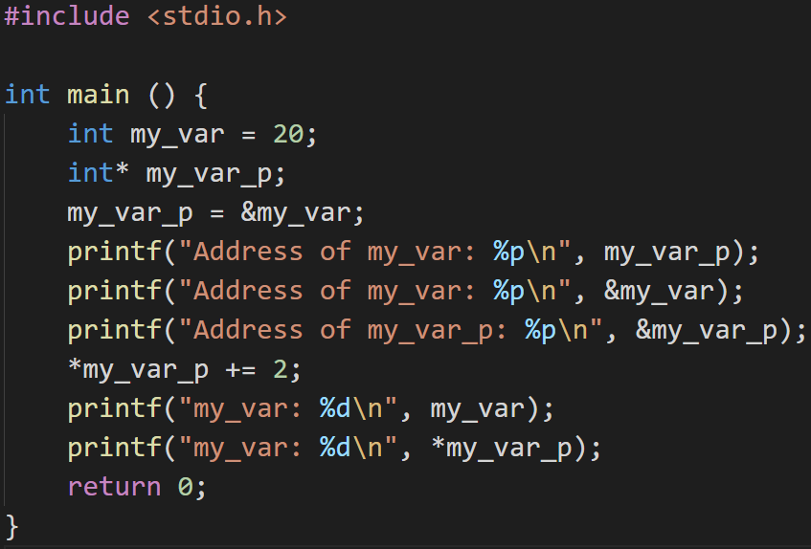
Pointers
0xebafb32c
What will this print?

Slide 17
Pointers
0xebafb32c
0xebafb32c

Slide 18
Pointers
0xebafb32c
0xebafb32c
What will this print?

Slide 19
Pointers
0xebafb32c
0xebafb32c
Another address, ex: 0xebafb320

Slide 20
Pointers
0xebafb32c
0xebafb32c
0xebafb320
What will this print?

Slide 21
Pointers
0xebafb32c
0xebafb32c
0xebafb320
22

Slide 22
Pointers
0xebafb32c
0xebafb32c
0xebafb320
22
What will this print?

Slide 23
Pointers
0xebafb32c
0xebafb32c
0xebafb320
22
22

Slide 24
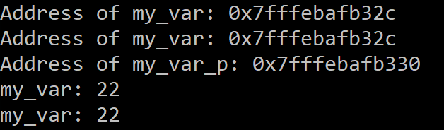
Pointers
&x = address of x
*x = contents at x
Address
Data
0xebafb32c
22
&my_var
my_var
*my_var_p
0xebafb330
0xebafb32c
&my_var_p
my_var_p
Notes:
Review syntax for
Declaring a pointer
Address of operator
Dereferencing a pointer

Slide 25
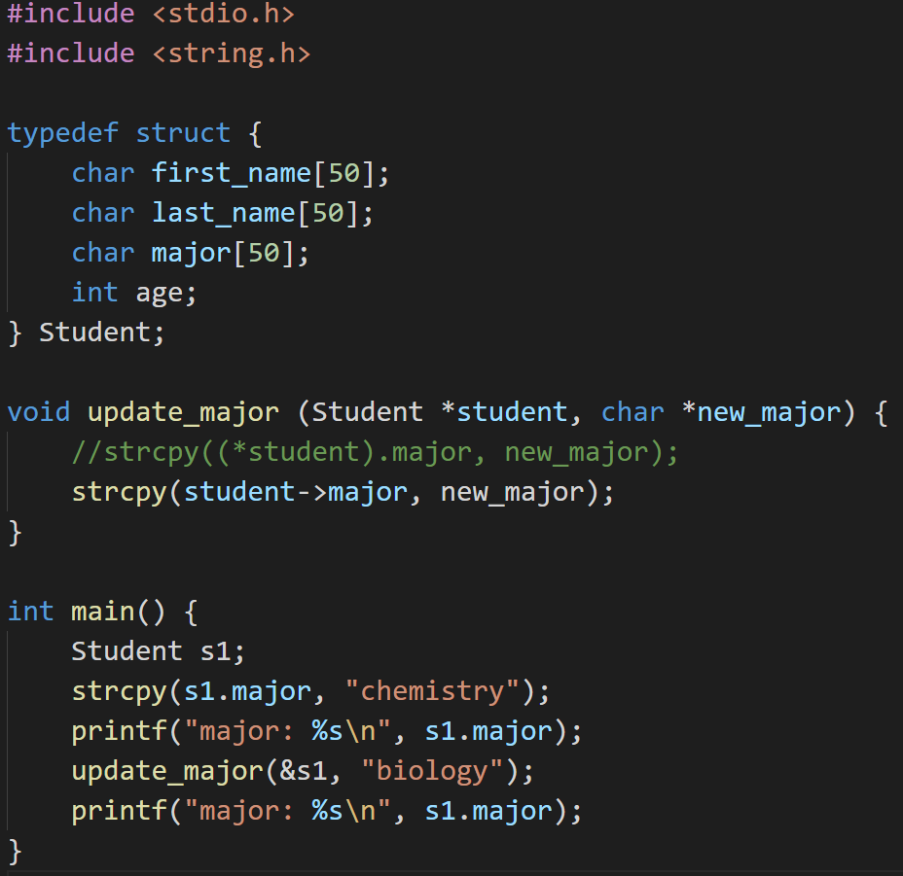

Pointers to Structs
Pass a pointer of a struct to a function so that you can edit the contents
Access the struct contents by:
(*student).major
student->major
Arrow operator
Notes:
Discuss the difference between the dot and the arrow operator and when each is used

Slide 26
Arrays
A block of memory: size is static
int arr[2];
int arr[] = {1, 2};
Accessing elements: array indexing
arr[1]
An array variable is a “pointer” to the first element.
You can use pointers to access arrays!
arr[0] is the same as *arr
Can use pointer arithmetic to move the pointer
Each operation automatically moves the size of one whole “type” that ptr points to
arr[1] is the same as *(arr + 1)
Arrays do not keep track of their own size

Slide 27
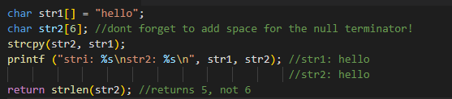
Strings
An array of chars representing individual characters
Ends in a null terminator ‘\0’
strlen(char* string)
returns the length of the string (num chars until the null terminator)
strcpy(char* dest, char* src)
copies the string stored in src to the location dest, until and including the null terminator

Slide 28
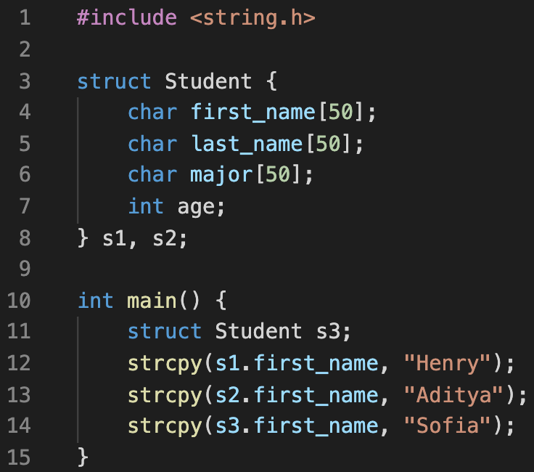
Structs
What do they allow us to do?
What is a structure tag?
What are the two ways to declare struct variables?
How do we access the members of a struct?
Structure Tag
Variable declarations
Notes:
Allow you to hold data items of different types in a single variable
Structure Tag: optional, allows you to create new variables of this struct outside of the struct definition
Two ways to declare variables
When you define the struct (s1, s2)
Using the structure Tag (s3)
Use the dot operator to access struct members

Slide 29
Structs
What do they allow us to do?
What is a structure tag?
What are the two ways to declare struct variables?
How do we access the members of a struct?
Dot operator
Notes:
Allow you to hold data items of different types in a single variable
Structure Tag: optional, allows you to create new variables of this struct outside of the struct definition
Two ways to declare variables
When you define the struct (s1, s2)
Using the structure Tag (s3)
Use the dot operator to access struct members

Slide 30
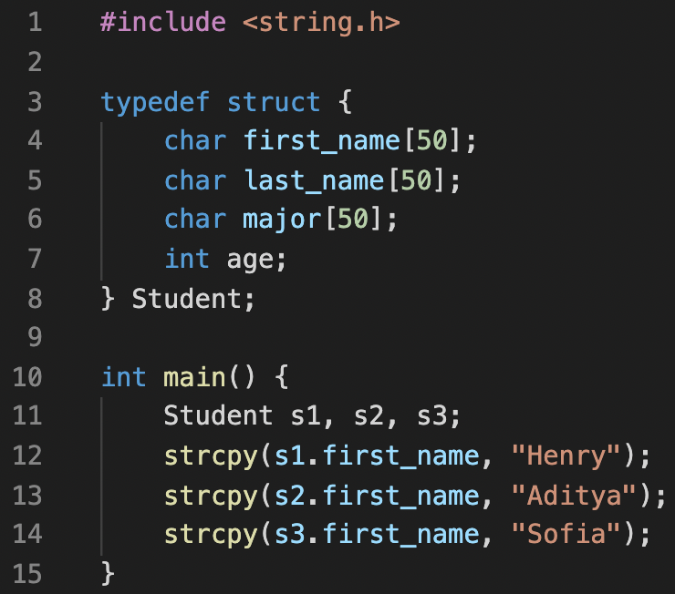
Structs
typedef
Lets you avoid rewriting struct every time you want to declare a new struct variable
Can no longer declare variables in the struct definition

